Slide 1
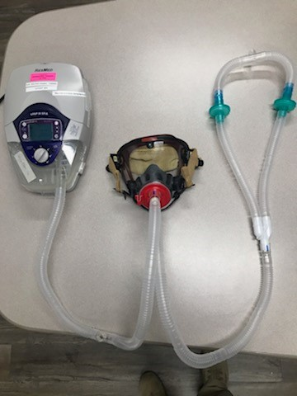
System Layout – CPAP/BiPAP

Slide 2
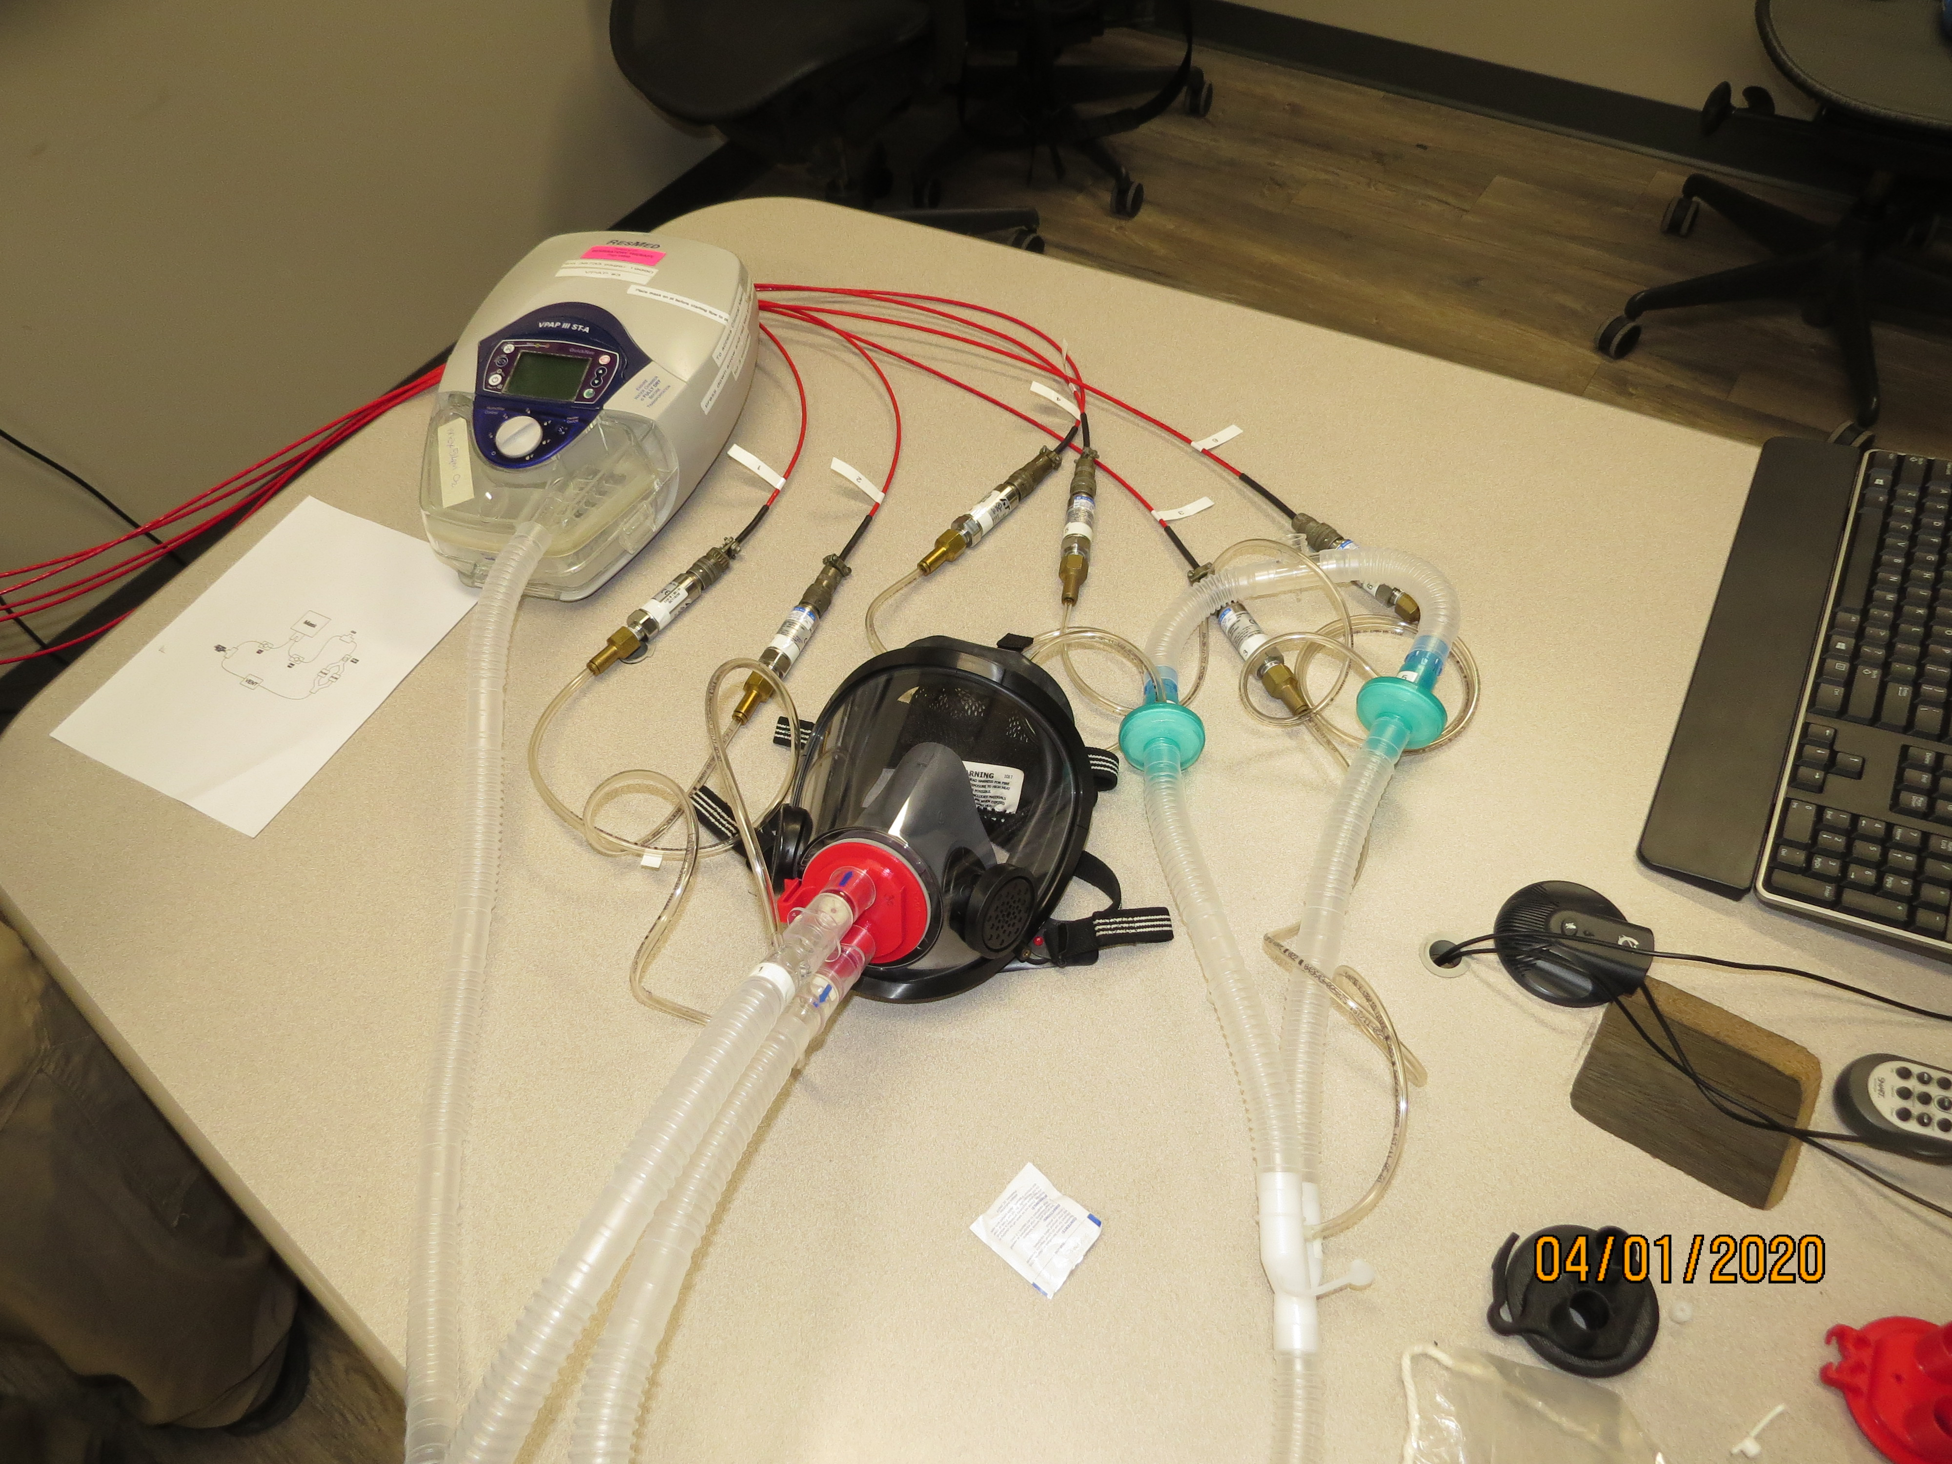
Initial Test Setup Photos

Slide 3
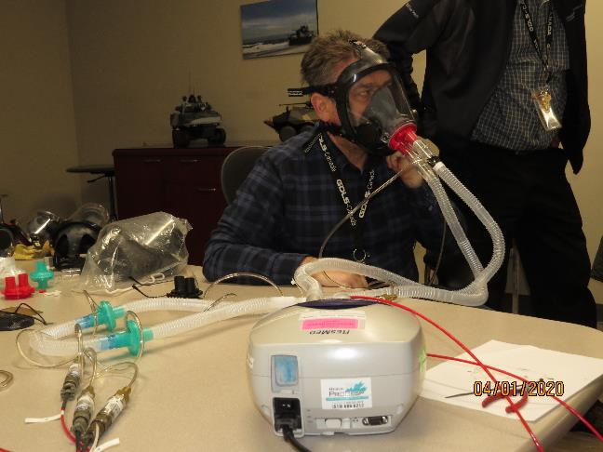
Initial Test Setup Photos

